Slide 1
KNOWLEDGE GRAPHS, SEMANTIC METADATA AND LLMS AT WORK FOR MARKETING CONTENT
Krasimira Bozhanova, Teodora Petkova
SEMANTiCS 2023
21.09.2023
Notes:
The private slides are here: https://docs.google.com/presentation/d/1iwG6Urf8vWLRz5sxKFBLjW030ic0J0Le/edit#slide=id.g28046c7ef8f_1_32

Slide 2
The talk at a glance
Who are we?
Why aim towards Knowledge-Graph Powered Marketing?
What is the Ontotext Knowledge Graph?
How to integrate LLMs with KGs and Semantic Metadata for more efficient knowledge exploration?

Slide 3
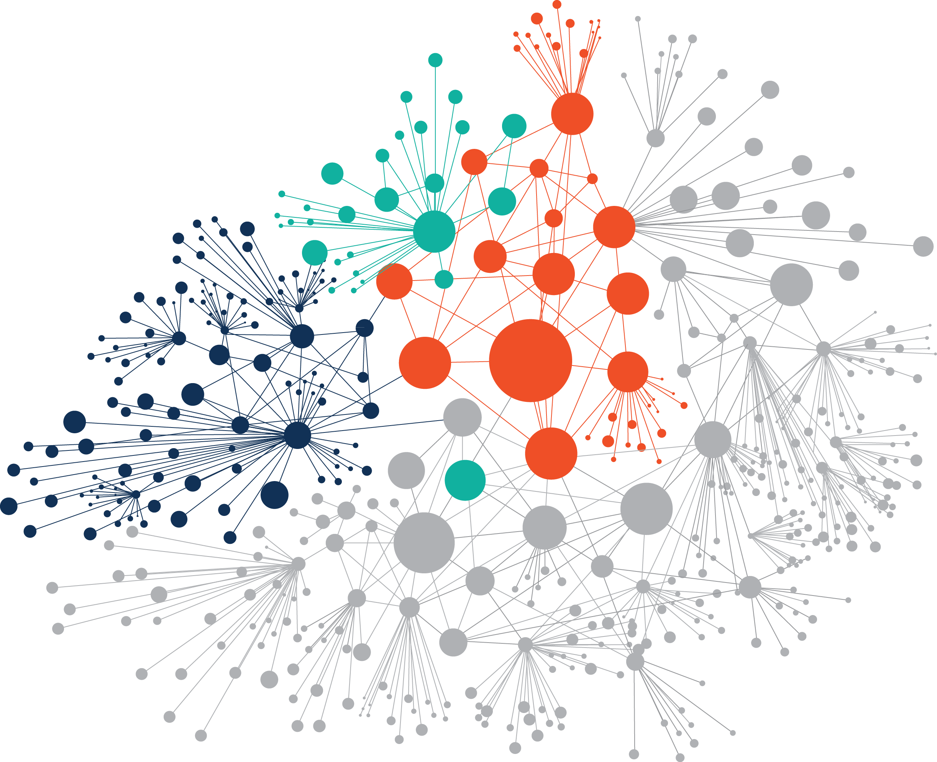
Ontotext at a Glance
Products
GraphDB - the best knowledge graph database
Ontotext Refine - enrich KGs from structured data
Ontotext Metadata Studio - enrich KGs from unstructured data
Services We build solutions around:
Crafting and evolving knowledge graphs, interlinking open and proprietary data
Applying text mining to enrich knowledge graphs and gain insights

Slide 4
Paradigm shift you say?

Slide 5
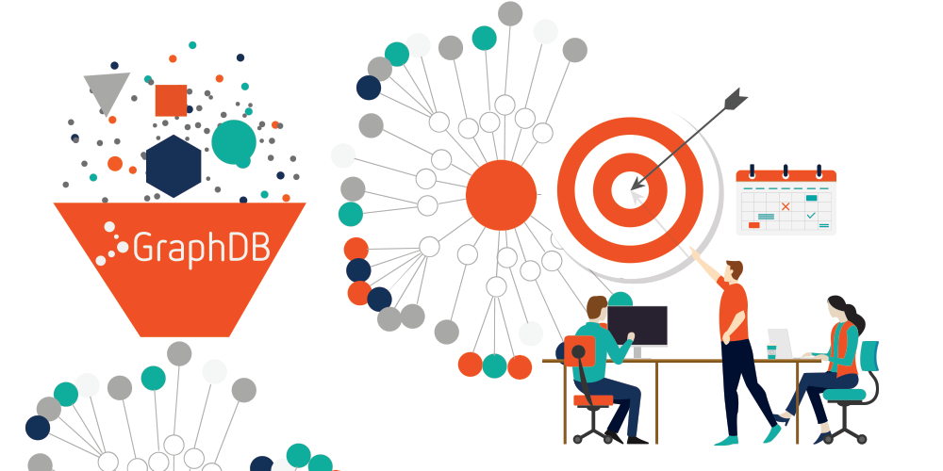
Shifting One Paradigm At a Time
Knowledge-graph powered marketing communication

Slide 6
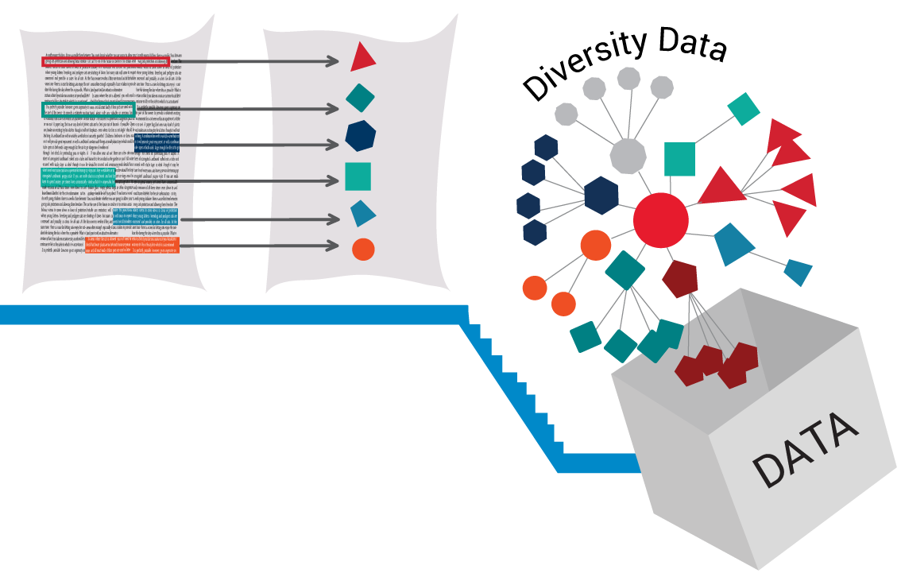
Ontotext Knowledge Graph in Figures
Shifting One Paradigm At a Time
500 059 Triples | 6 taxonomies | 3 ontologies | 1273 documents | 32 500 annotations

Slide 7
The Benefits of Knowledge Graph-Powered Marketing
CONTENT MANAGEMENT: We find, navigate, use and reuse content efficiently
SEO: We publish semantically annotated content for better visibility in search at a lower cost
KNOWLEDGE MANAGEMENT platform: We work to create structured content for products, services, technologies, events, people and projects. All this to serve both internal and external audiences.

Slide 8
And just like that…
We set ourselves in the position to talk to our content (help LLMs help us :)

Slide 9
Task
Help me turn my content into organized knowledge and make it easily accessible and understandable to users

Slide 10
Task Breakdown
Knowledge Representation
Help me turn my content into organized knowledge and make it easily accessible and understandable to users

Slide 11
Task Breakdown
Knowledge Representation
Ability to define domain vocabulary
Tag content with semantic metadata
Breakdown and store knowledge
Help me turn my content into organized knowledge and make it easily accessible and understandable to users

Slide 12
Ontotext Knowledge Graph

Slide 13
Task Breakdown
Knowledge Representation
Ability to define domain vocabulary
Tag content with semantic metadata
Breakdown and store knowledge
Knowledge Exploration
Help me turn my content into organized knowledge and make it easily accessible and understandable to users

Slide 14
Task Breakdown
Knowledge Representation
Ability to define domain vocabulary
Tag content with semantic metadata
Breakdown and store knowledge
Knowledge Exploration
Precision search combining FTS with graph query
State-of-the-art LLM chat
User intent at the center of information exploration
Help me turn my content into organized knowledge and make it easily accessible and understandable to users

Slide 15
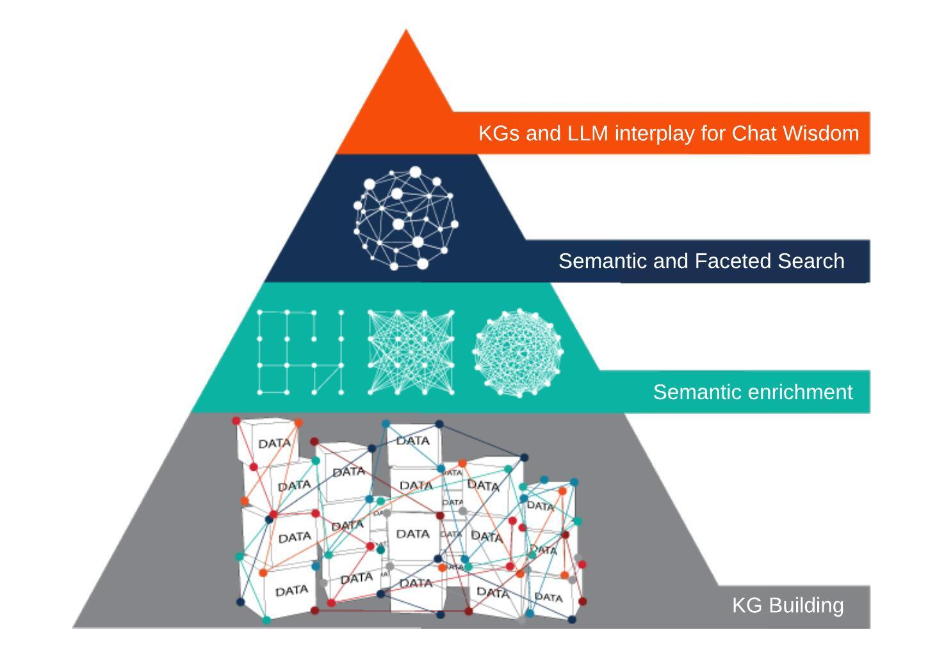
Task Breakdown

Slide 16
Demo

Slide 17
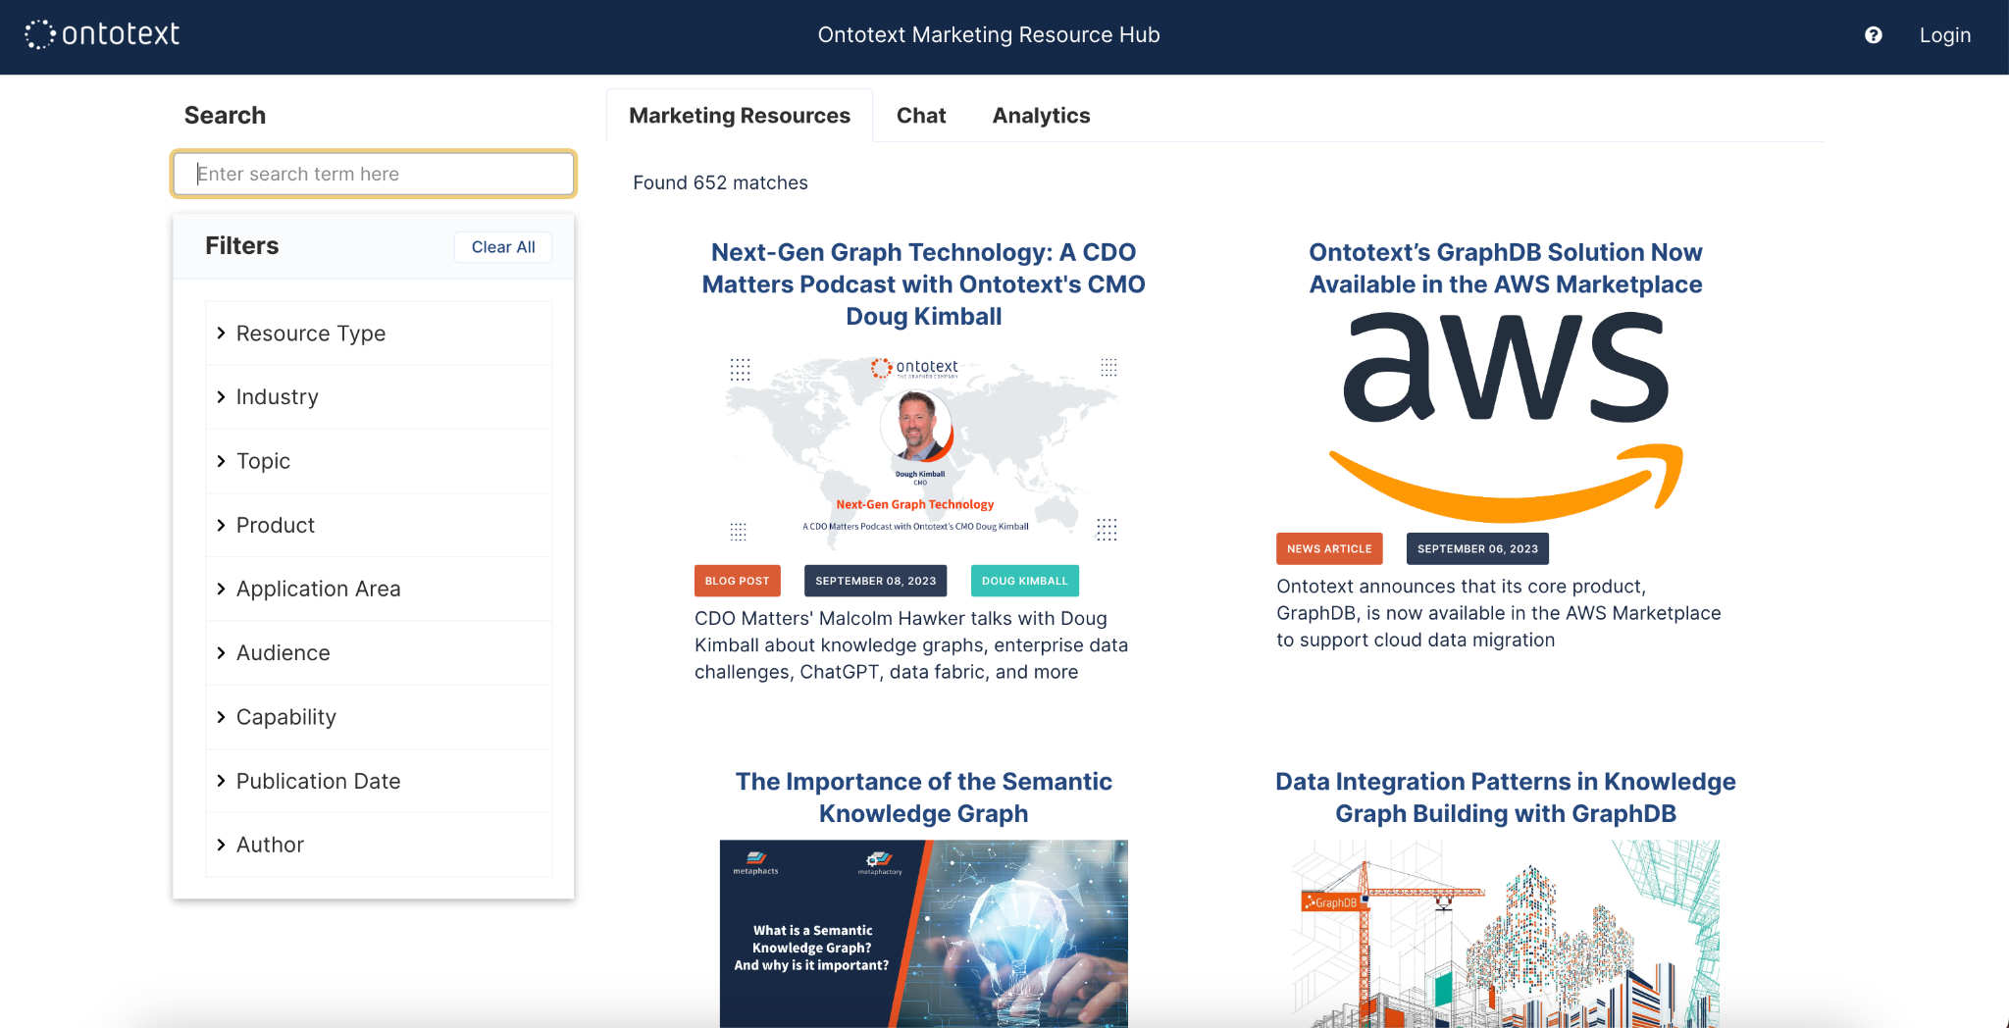

Slide 18
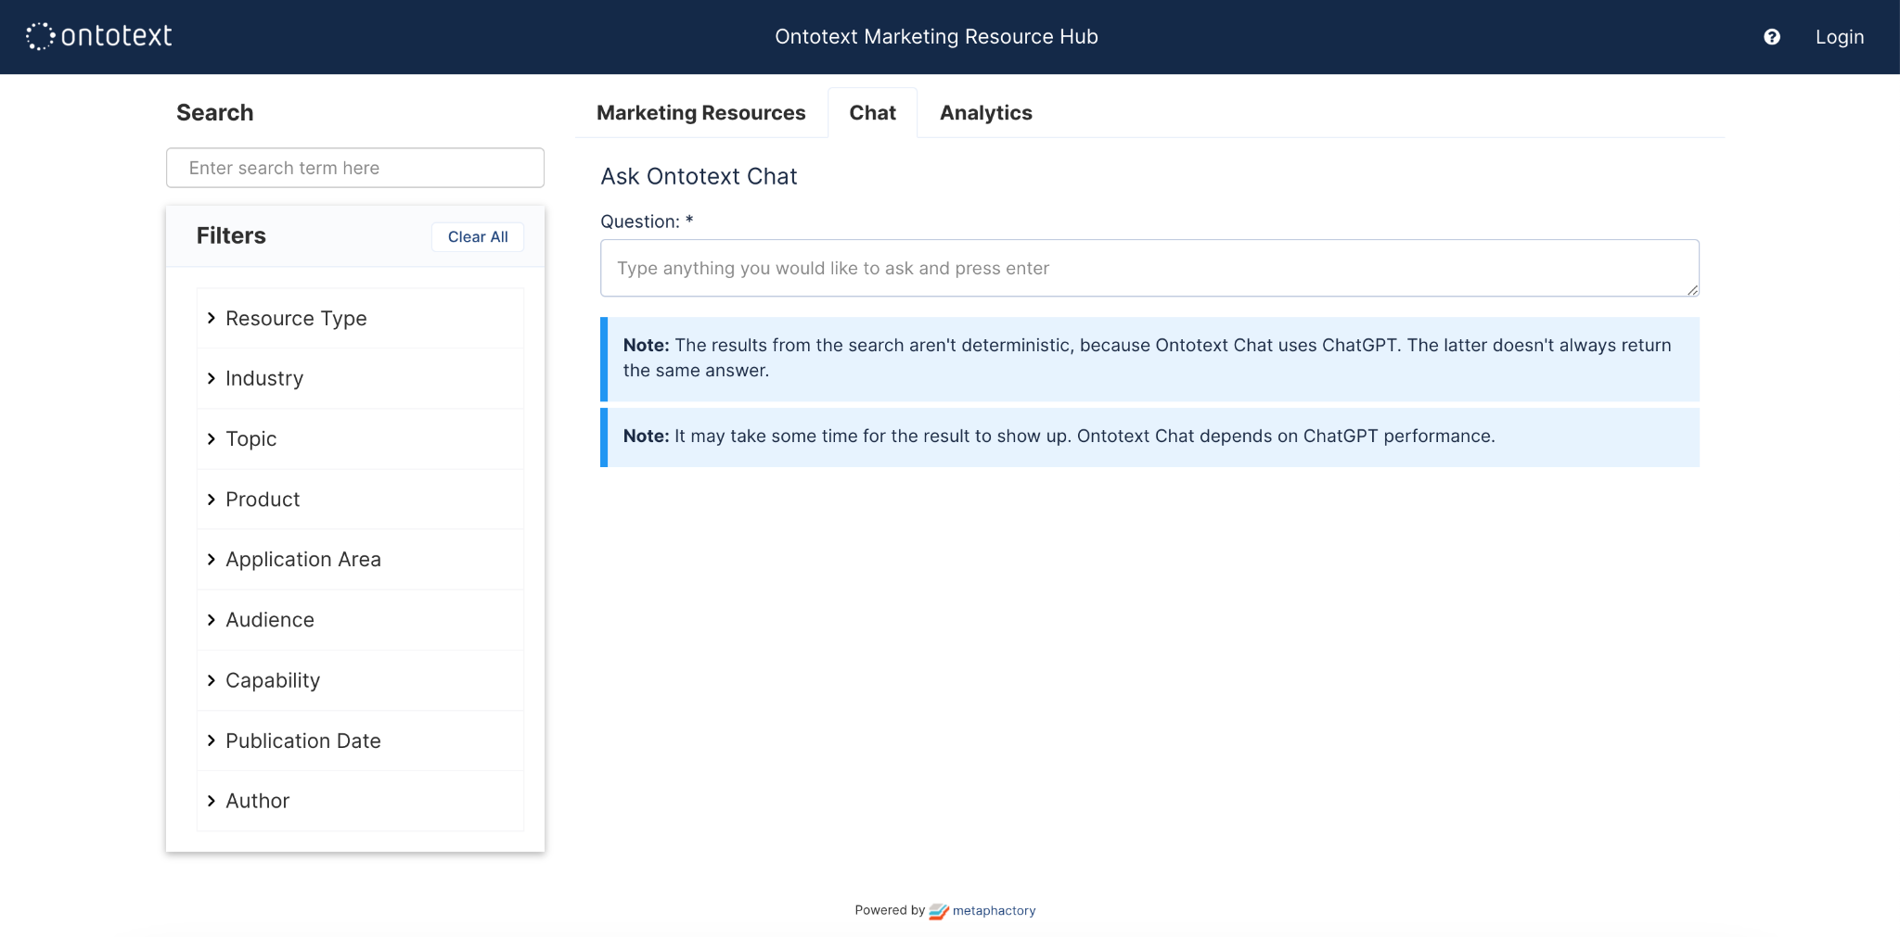

Slide 19
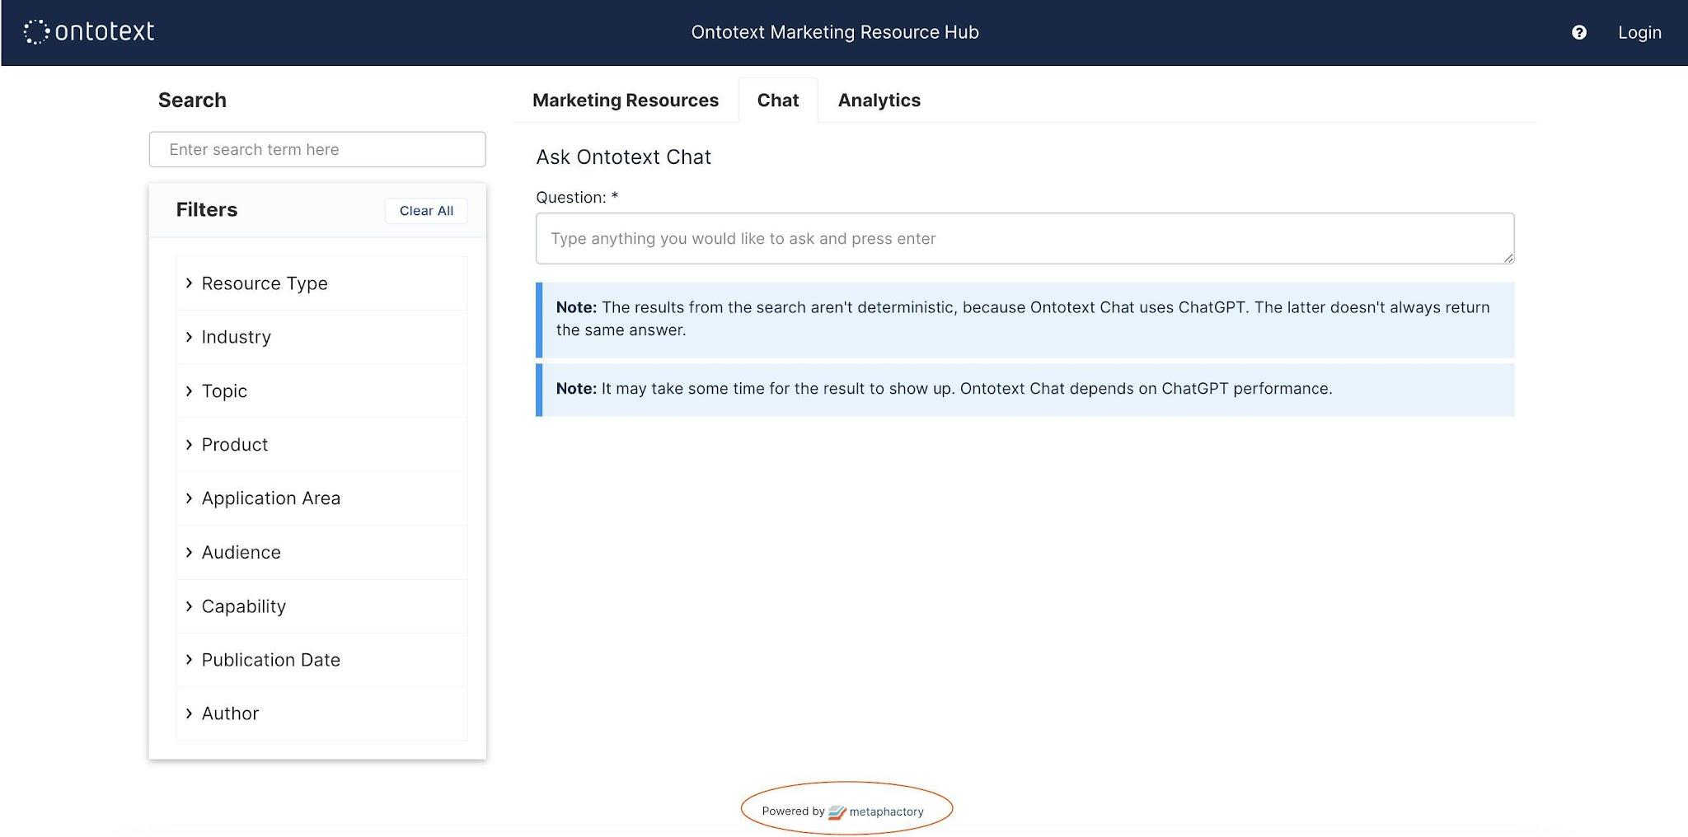

Slide 21
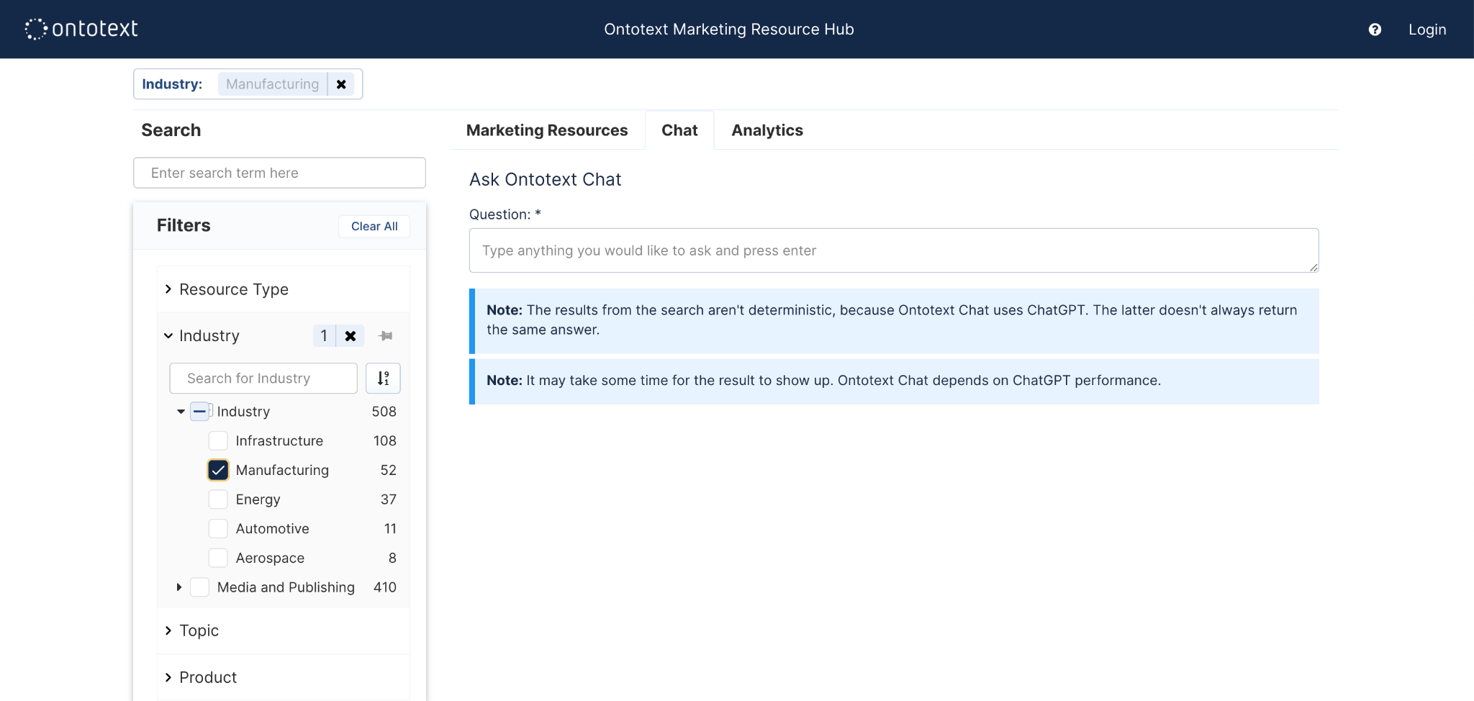

Slide 23
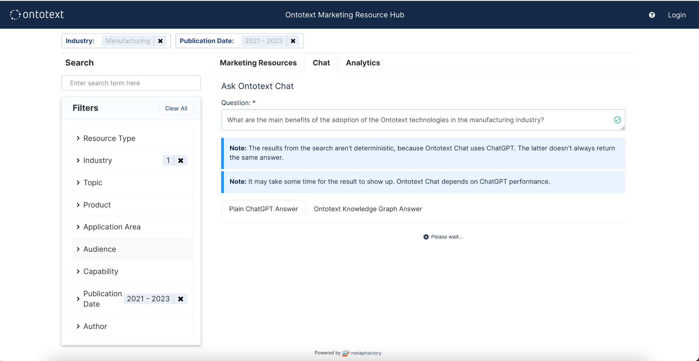

Slide 24
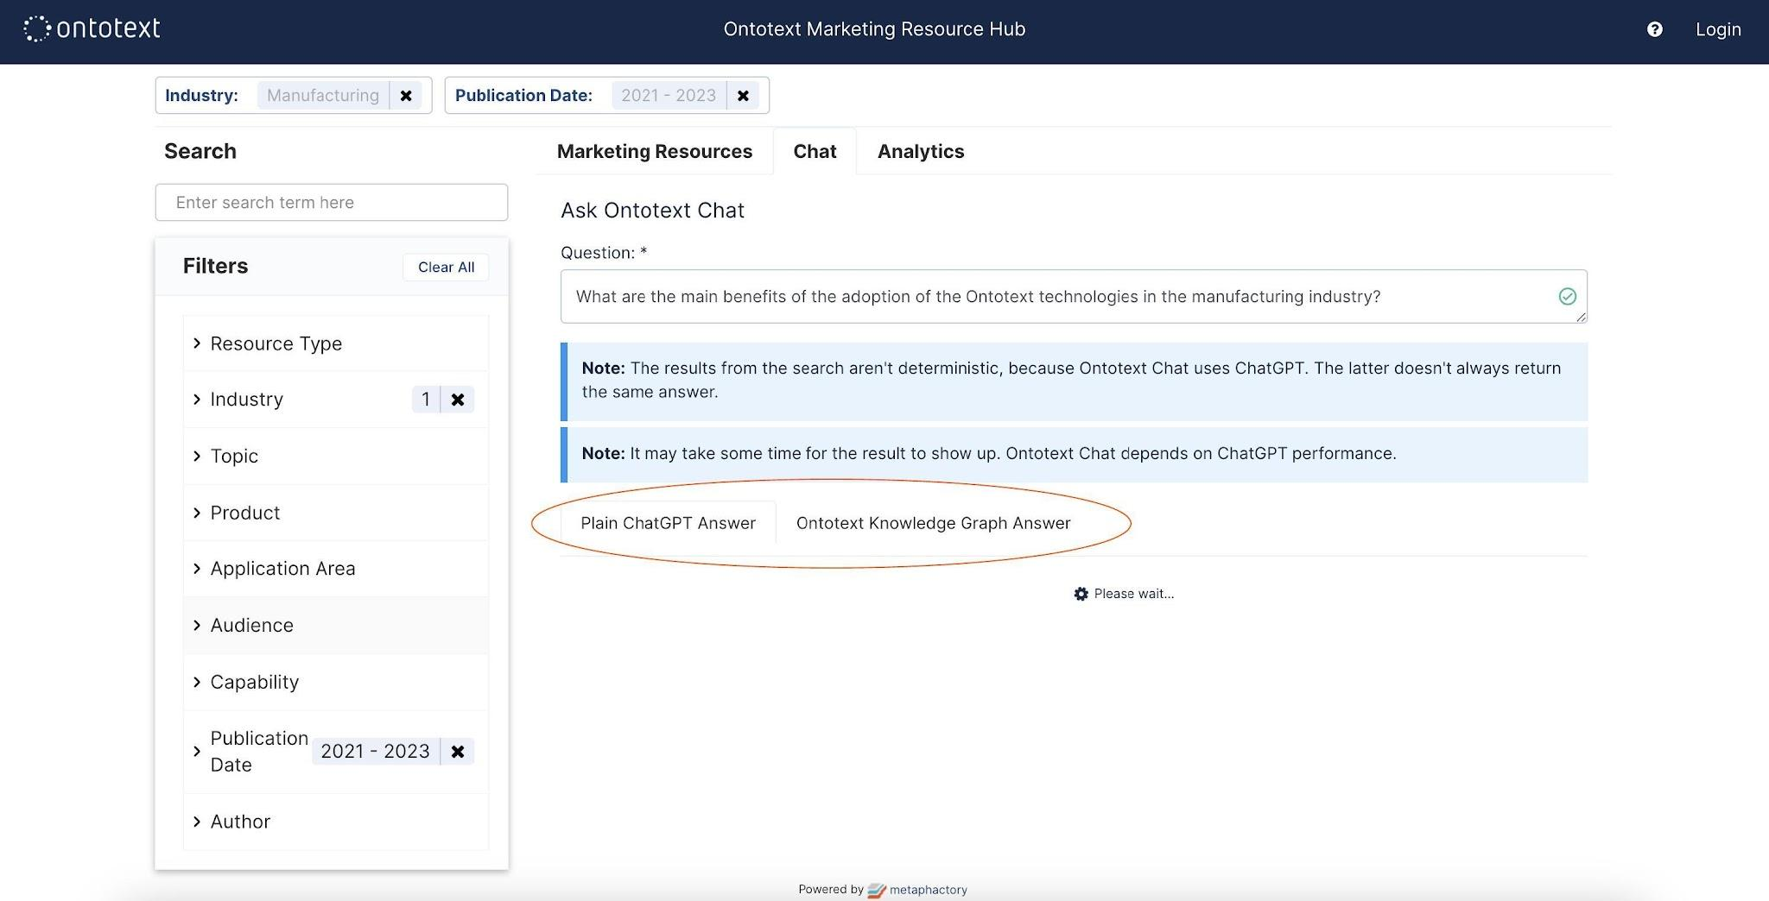

Slide 25
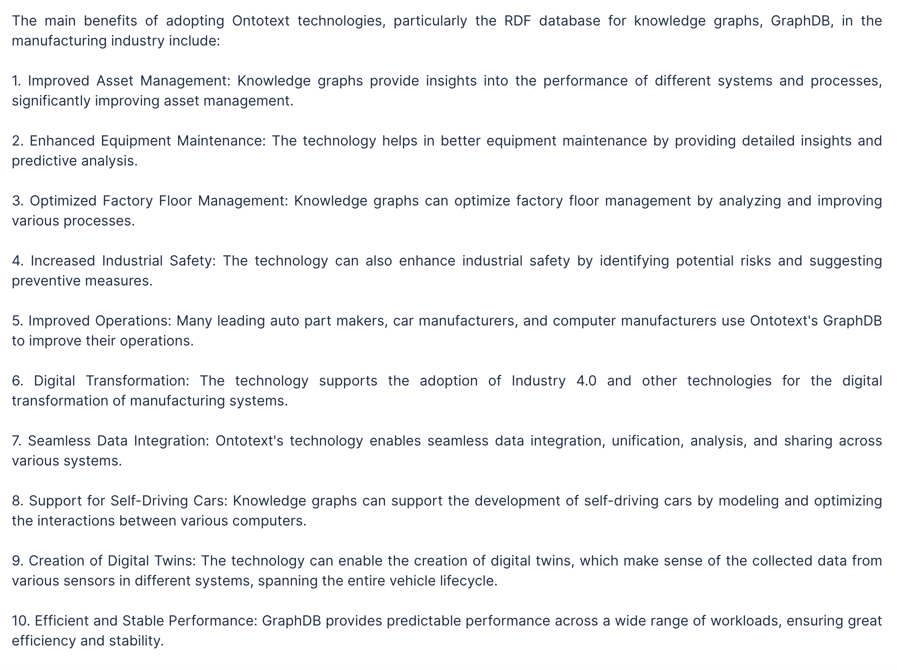

Slide 29
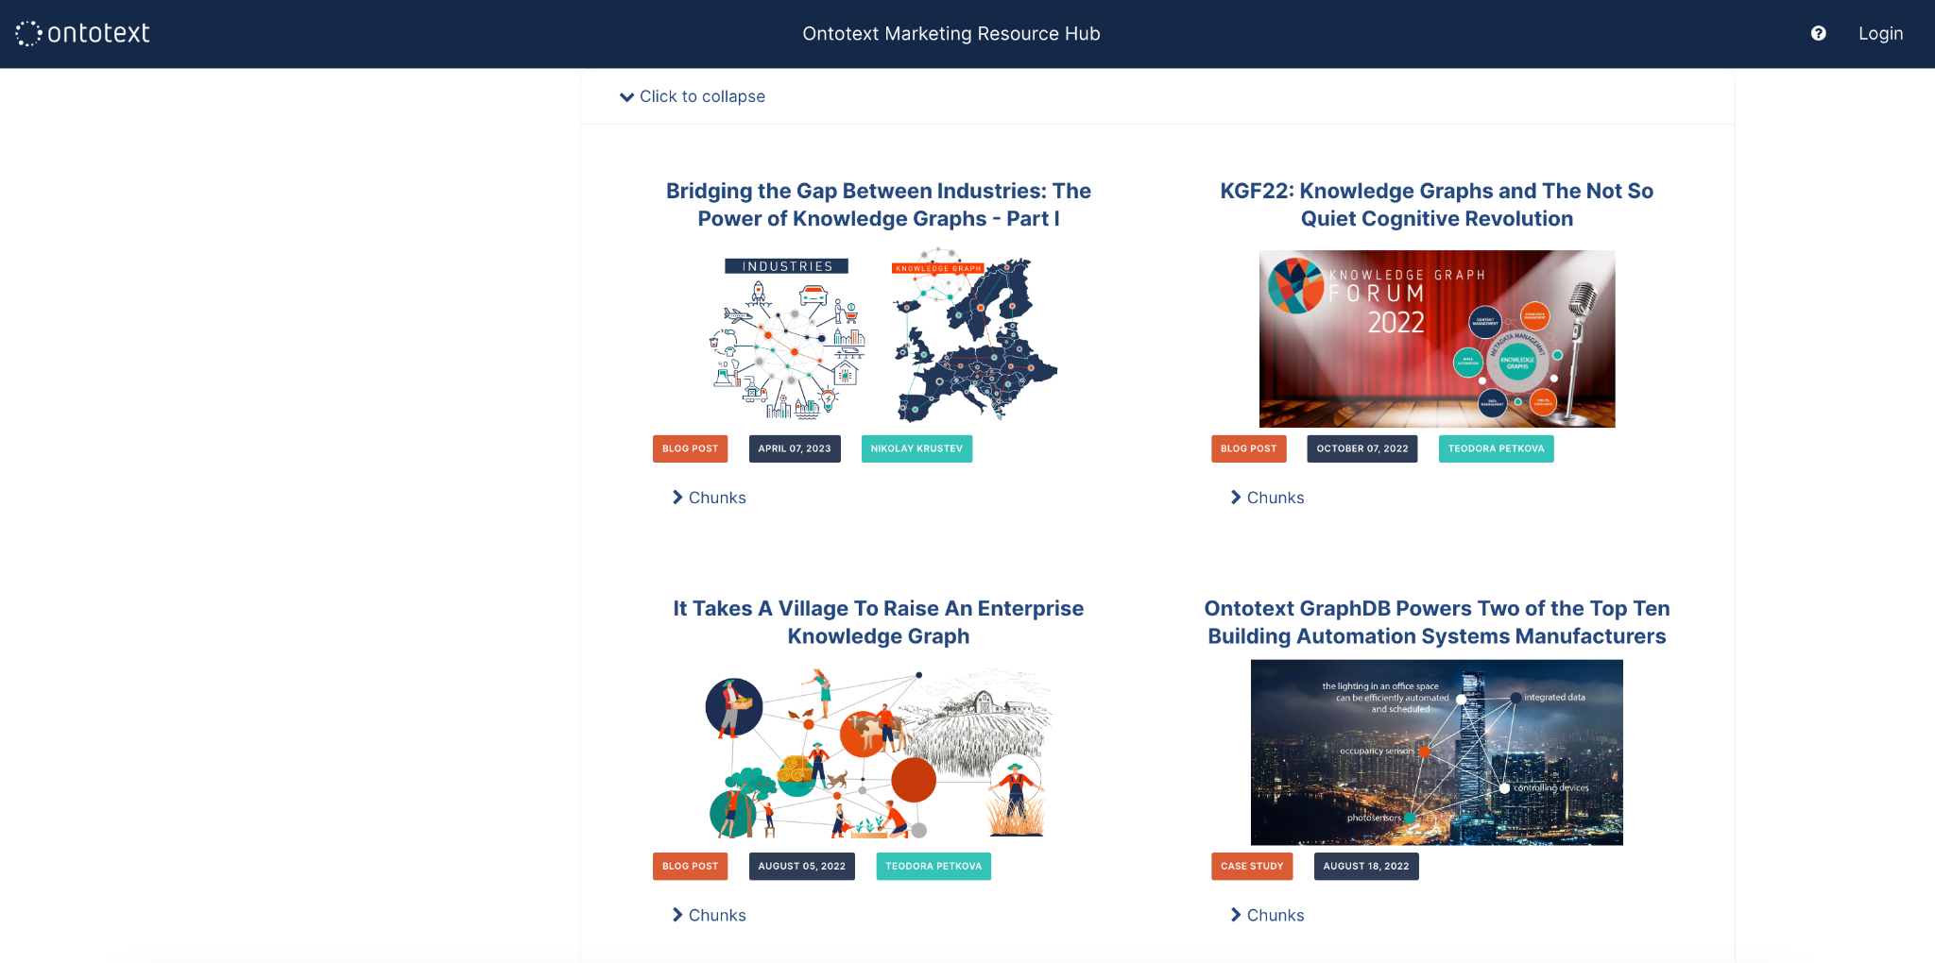

Slide 30
The Synergy between LLMs and KGs
Problem
LLMs are limited to public knowledge
Lack of trustworthiness: Hallucinations & unreliability
LLMs are Black-Box Models: No traceability, no explainability
Solution
Enhance LLM with your own structured and unstructured data
Provide the LLM with reliable grounding context
Provide traceability for the sources of the generated answer

Slide 31
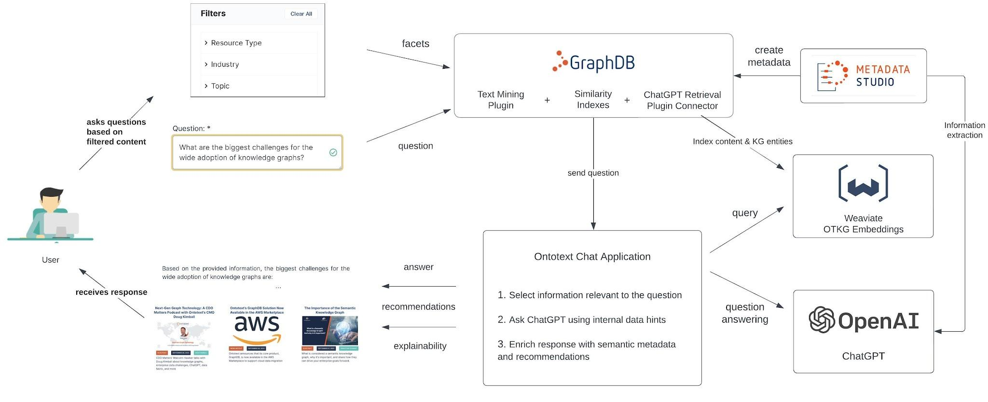
Making the Paradigm Shift Happen
Notes:
ref. https://graphdb.ontotext.com/documentation/10.3/gpt-queries.html?highlight=llm

Slide 32
Learning along the way
Problem
Handle large text
Lost context after splitting into chunks
Noise in original text
“The NASA problem”
Challenges to match user question to content embeddings
Query limitations
Difficulty answering questions that require broader view over the data
Solution
Reference resolution
Targeted information retrieval
Query expansion
Content enrichment
Vector embeddings of KG entities
NLQ along the way…

Slide 33
Takeaways
LLMs and KGs can be integrated successfully for real-world applications
Knowledge graphs combined with semantic metadata enhance LLMs for better content discovery, understanding and question-answering.
Innovative approaches elevate the value of the marketing content we produce and unlock the potential for powerful knowledge-driven insights.
Notes:
We are already bearing the fruits of a KG coupled with LLM for powerful knowledge-driven experiences, imagine any other domain.

Slide 34
Thank you
for your time!
teodora.petkova@ontotext.com
krasimira.bozhanova@ontotext.com
www.ontotext.com

